Slide 1

NBA Stat Anaylsis
By Andreas Sudarto,
Luc Ravenelle

Slide 2
Ideas and role collab
Predicting next year stat
Using visualization
Role
Andreas: Scraping
Luc: Data analyzing and predicting

Slide 3
Tools
Language:
Python
R
Library:
BS4

Slide 4
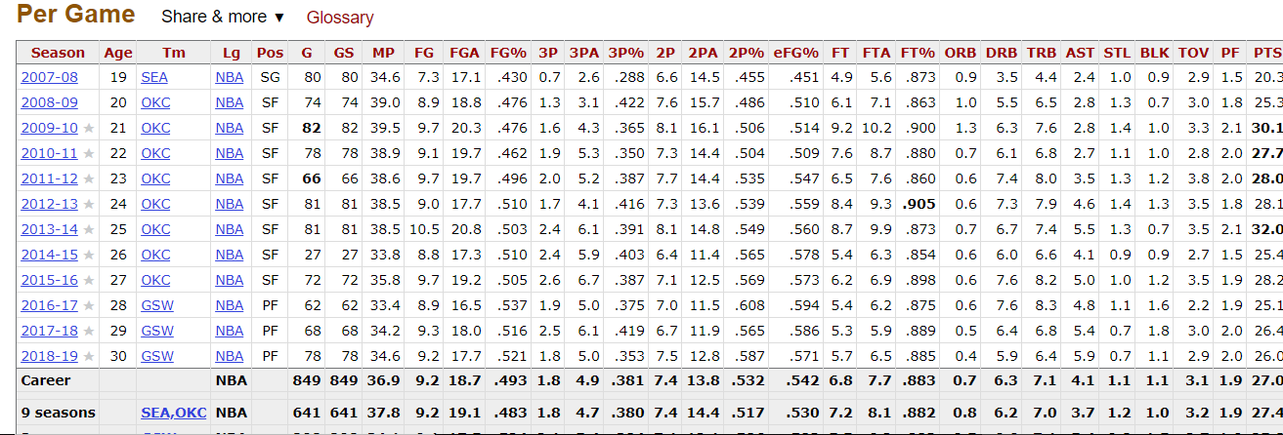
Source
NBA Reference
Table

Slide 5
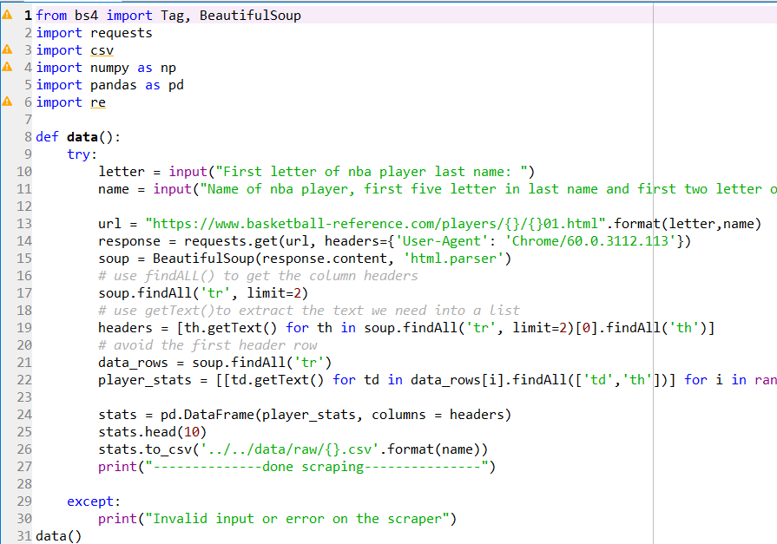
Scraping
Library BeautifulSoup
Scrape the TR and TH tag to get all the stats

Slide 6
Analysis
Method/Technique:
Using Training/Test set Data to make the prediction
Naïve Bayes
Drift Forecast
Margin of Error:
Not very accurate

Slide 7
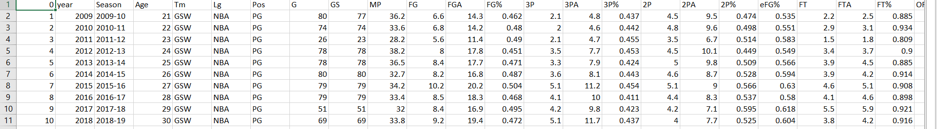
Data

